Slide 1
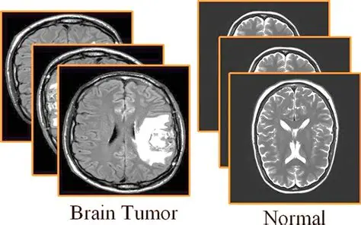
Brain Tumor Classification with Deep Learning
By: Angeles Olvera

Slide 2

Context
NeuroScan Diagnostics, is based in San Diego, CA, and is a leader in AI powered medical imaging and diagnostics. San Diego is renowned for its cutting edge research in neurology and biomedical sciences, making it the perfect environment for innovating advanced tumor detection models.
Success Metrics
Accurate and timely classification of tumors based on MRI scans. The model must have high evaluation metric scores for precision, recall, F1- score, and accuracy.
Constraints
MRI scan quality, patient positioning, and imaging equipment may affect the reliability of the model's predictions.
Stakeholders
Dr. Olivia Matthews – will provide clinical expertise to ensure the model aligns with real world radiology practices
Problem
NeuroScan Diagnostics has been contracted by a San Diego based hospital to develop a deep learning model for brain tumor classification using MRI data to help their radiology department make faster and more accurate classifications. They are focusing on classifying glioma tumors, meningioma tumors, pituitary tumors, or no tumor.

Slide 3
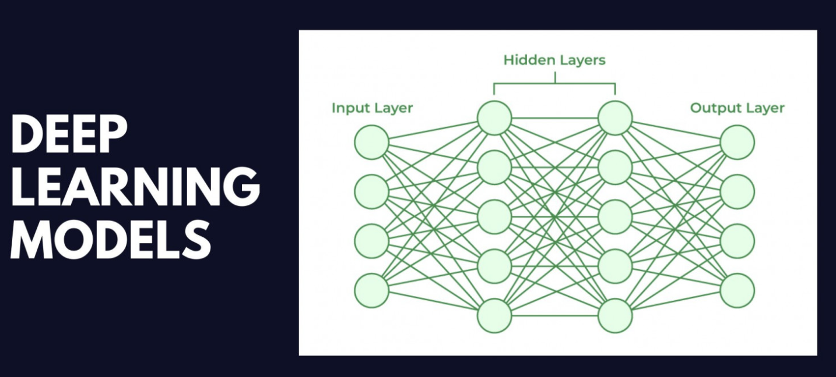
Type of Problem
This is a supervised image classification task focused on detecting brain tumor types from MRI scans. Will be solved by using deep learning models.
Deep learning models are machine learning models that use layers of interconnected nodes (neurons) to learn from data. The “deep” part comes from having many layers, each layer extracts more abstract features.
Data Description
Downloaded from Kaggle
The training set contains 3,310 images, while the test set includes 394 images.
Each image is a 2D grayscale scan with a resolution of 240x240 pixels.
Each training and testing image folder has a corresponding folder with the label of the image identifying what tumor or if no tumor is in the image.
Project Workflow
Step 1: Data Wrangling and Pre-Processing
Step 2: Exploratory Data Analysis (EDA)
Step 3: Model Selection & Training
Step 4: Model Predictions and Evaluations
Step 5: Model Optimization
Step 6: Testing the Final Model

Slide 4
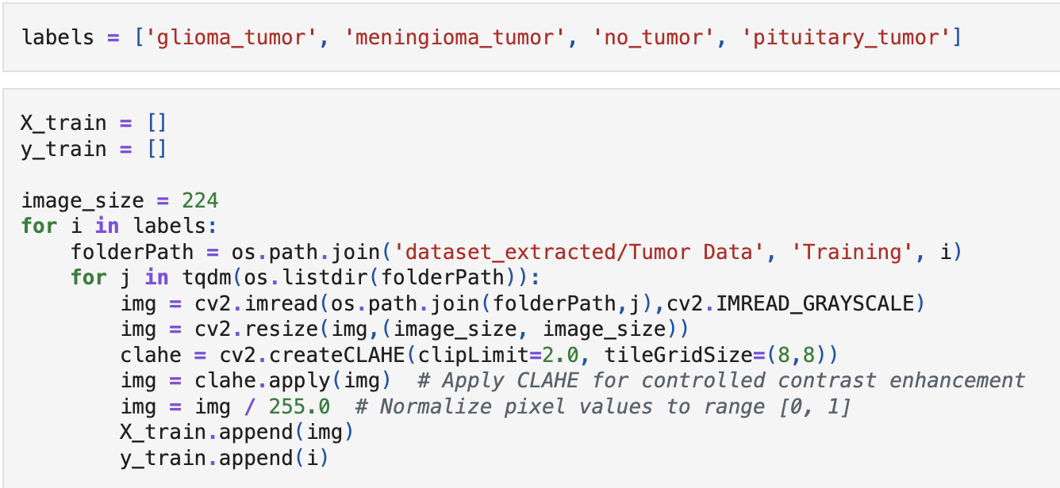
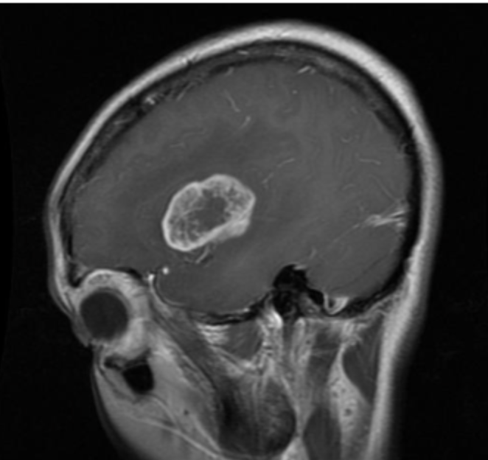
Data Wrangling and Pre-Processing
Building on the previously described dataset, the following steps were taken for deep learning model training.
Data Extraction
Used Python zipfile library to extract contents
Organized into folders per class
Paths mapped using label-driven for loops
Image Preprocessing
Grayscale conversion for consistent visualization (cv2.IMREAD_GRAYSCALE)
Resized to 224×224 for model compatibility
Applied CLAHE for localized contrast enhancement
clipLimit=2.0, tileGridSize=(8,8)
Normalized pixel values to [0,1] scale
Data Preparation
Processed images stored in X_train, X_test
Corresponding labels stored in y_train, y_test
tqdm progress bar used for efficiency tracking
Image Before transformations

Slide 5
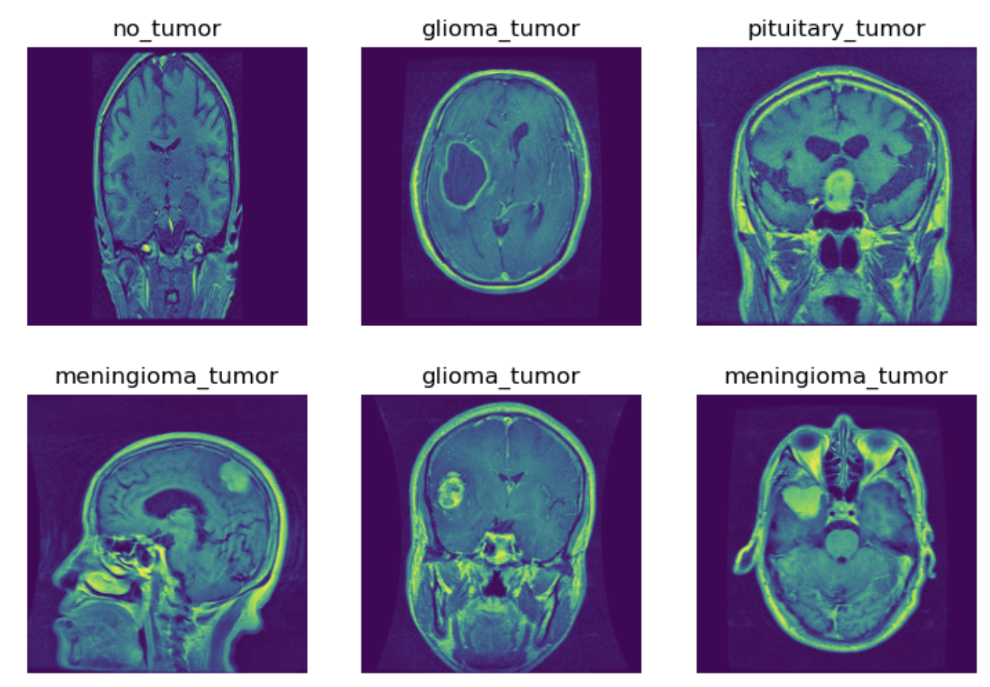
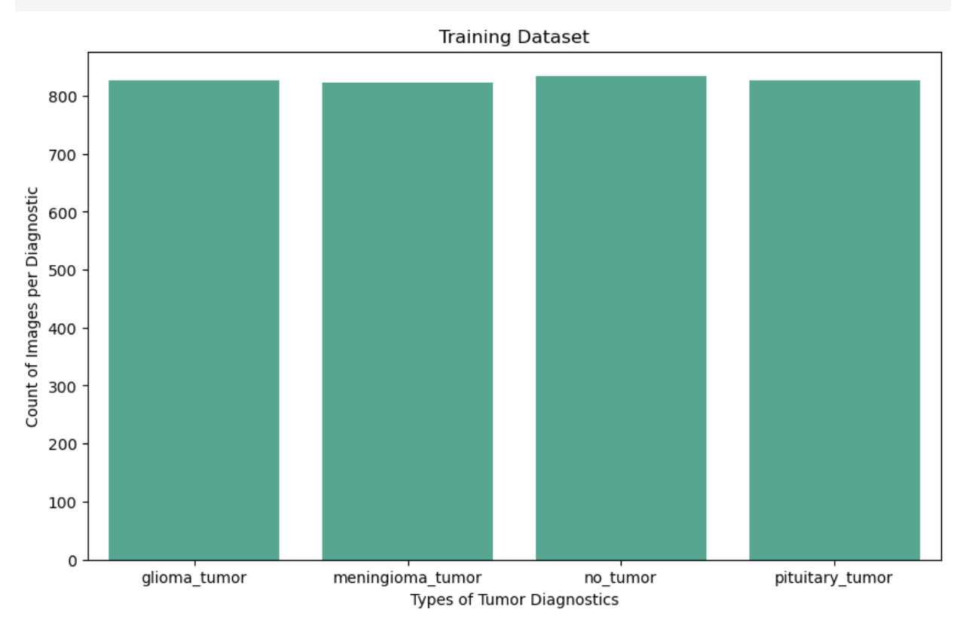
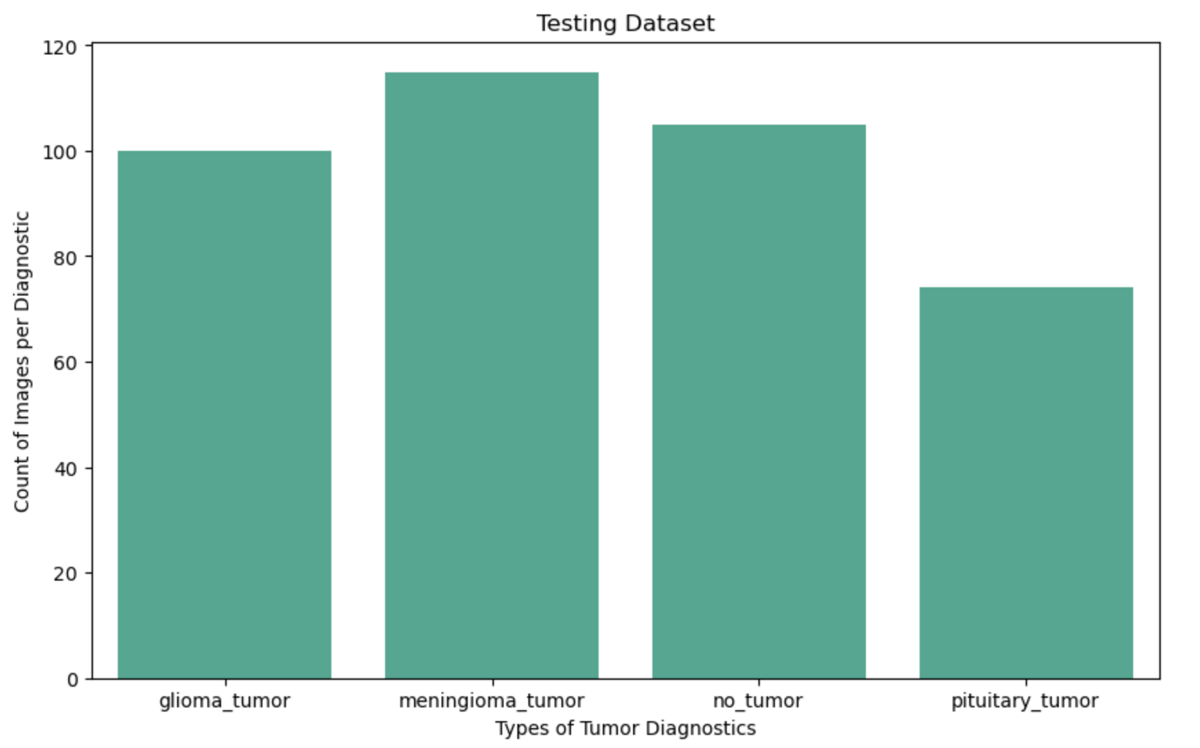
Exploratory Data Analysis
Visual Checks After Transformations
Random MRI samples printed from training/testing sets
CLAHE preprocessing improved contrast in low-detail regions
Dataset Shape
Training set: 3,310 images at 224×224 pixels
Test set: 394 images at 224×224 pixels
Class Balance
Training data: Balanced across 4 categories
Testing data: Imbalanced — relied on precision, recall, F1-score for fair evaluation

Slide 6
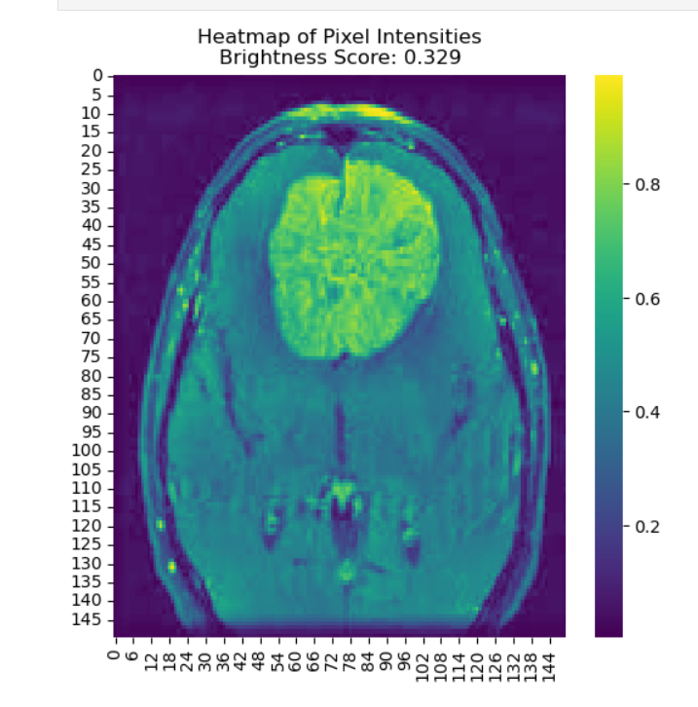
Exploratory Data Analysis
Pixel Intensity Heatmaps
Visualized brightness across scans
Bright regions linked to potential tumor presence
Aids interpretation and supports quality assurance before model training
RGB Conversion
Converted grayscale images to 3-channel RGB
Image arrays renamed: X_train_rgb, X_test_rgb
Ensures compatibility with ImageNet-pretrained CNN models
Label Preparation
Used LabelEncoder() for numeric conversion of categories
Created both encoded (y_train_encoded, y_test_encoded) and one-hot versions (y_train_cat, y_test_cat)

Slide 7
Model Selection & Training
ResNet50 Custom Model Setup
Pretrained on ImageNet
Used include_top=False to remove default classifier
Added GlobalAveragePooling2D to compress features
Dropout(0.5) for regularization
Dense(128) layer with ReLU activation
Dropout(0.25) for regularization
Dense(4) with Softmax activation for 4-class prediction
Compiled with Adam, categorical cross-entropy, and accuracy
Trained on X_train_rgb and y_train_cat
Purpose: Balanced depth with strong feature learning, suited for smaller dataset
DenseNet121 Custom Model Setup
Pretrained on ImageNet
Used include_top=False to replace default classifier
Dense(64) layer with ReLU activation
Dropout(0.5) for regularization
Dense(4) with Softmax for final prediction
Compiled with Adam, categorical cross-entropy, and accuracy
Trained on X_train_rgb and y_train_cat
Purpose: Test deeper architecture vs. smaller neuron count for performance
Xception Custom Model Setup
Pretrained on ImageNet
Used include_top=False to insert custom classifier
Added GlobalAveragePooling2D layer for shape and texture focus
Dense(64) layer with ReLU activation
Dropout(0.3) for light regularization
Dense(4) with Softmax activation for class prediction
Compiled with Adam, categorical cross-entropy, and accuracy
Trained on X_train_rgb and y_train_cat
Purpose: Explore modular feature extraction and channel wise learning

Slide 8
Model Predictions and Evaluations
Evaluation Strategy
Created a modular evaluate() function for model performance
Used classification_report from sklearn to extract:
Precision, Recall, F1-Score — converted to percentages
Focused on clinically relevant metrics due to test set imbalance
Added separate accuracy() function
Prediction Strategy
Created prediction function for modular evaluation
Used np.argmax on model outputs to identify class predictions
ResNet50 Evaluation Summary
Precision: 63.68%
Recall: 59.00%
F1-Score: 59.87%
Accuracy: 59%
Struggled to classify tumors reliably
Fewer layers with more neurons led to overfitting
Conclusion: Underperformed—insufficient for medical-grade reliability
DenseNet121 Evaluation Summary
Precision: 88.54%
Recall: 88.49%
F1-Score: 88.34%
Accuracy: 88%
Deep architecture captured complex tumor patterns
Balanced generalization across all classes
Conclusion: Strong performance, clinically promising
Xception Evaluation Summary
Precision: 89.35%
Recall: 89.45%
F1-Score: 89.23%
Accuracy: 89%
Modular learning boosted subtle detail detection
Slight edge over DenseNet121 in all metrics
Conclusion: Top-performing model ideal for further fine-tuning

Slide 9
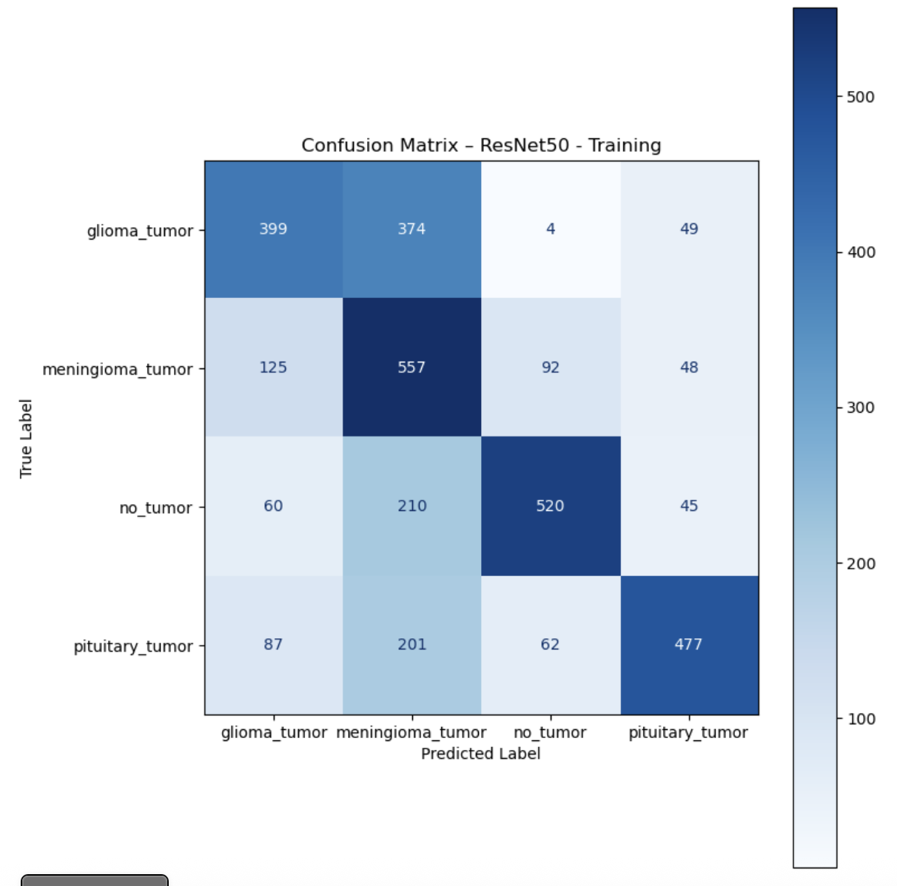
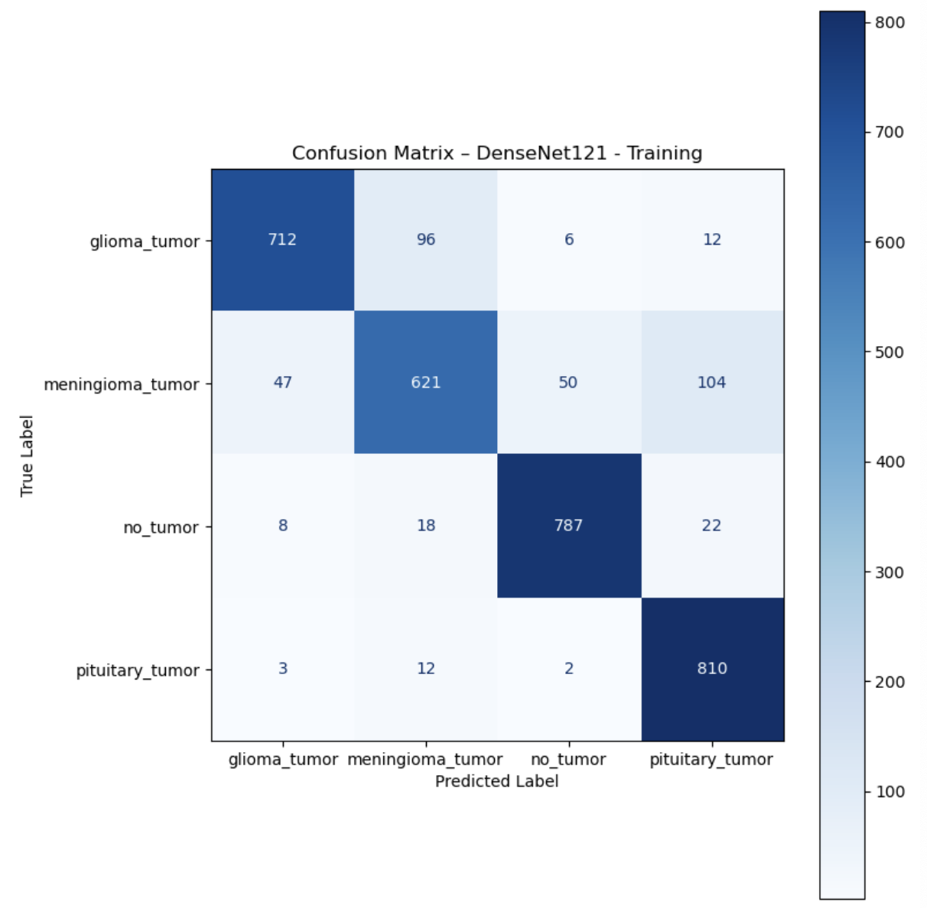
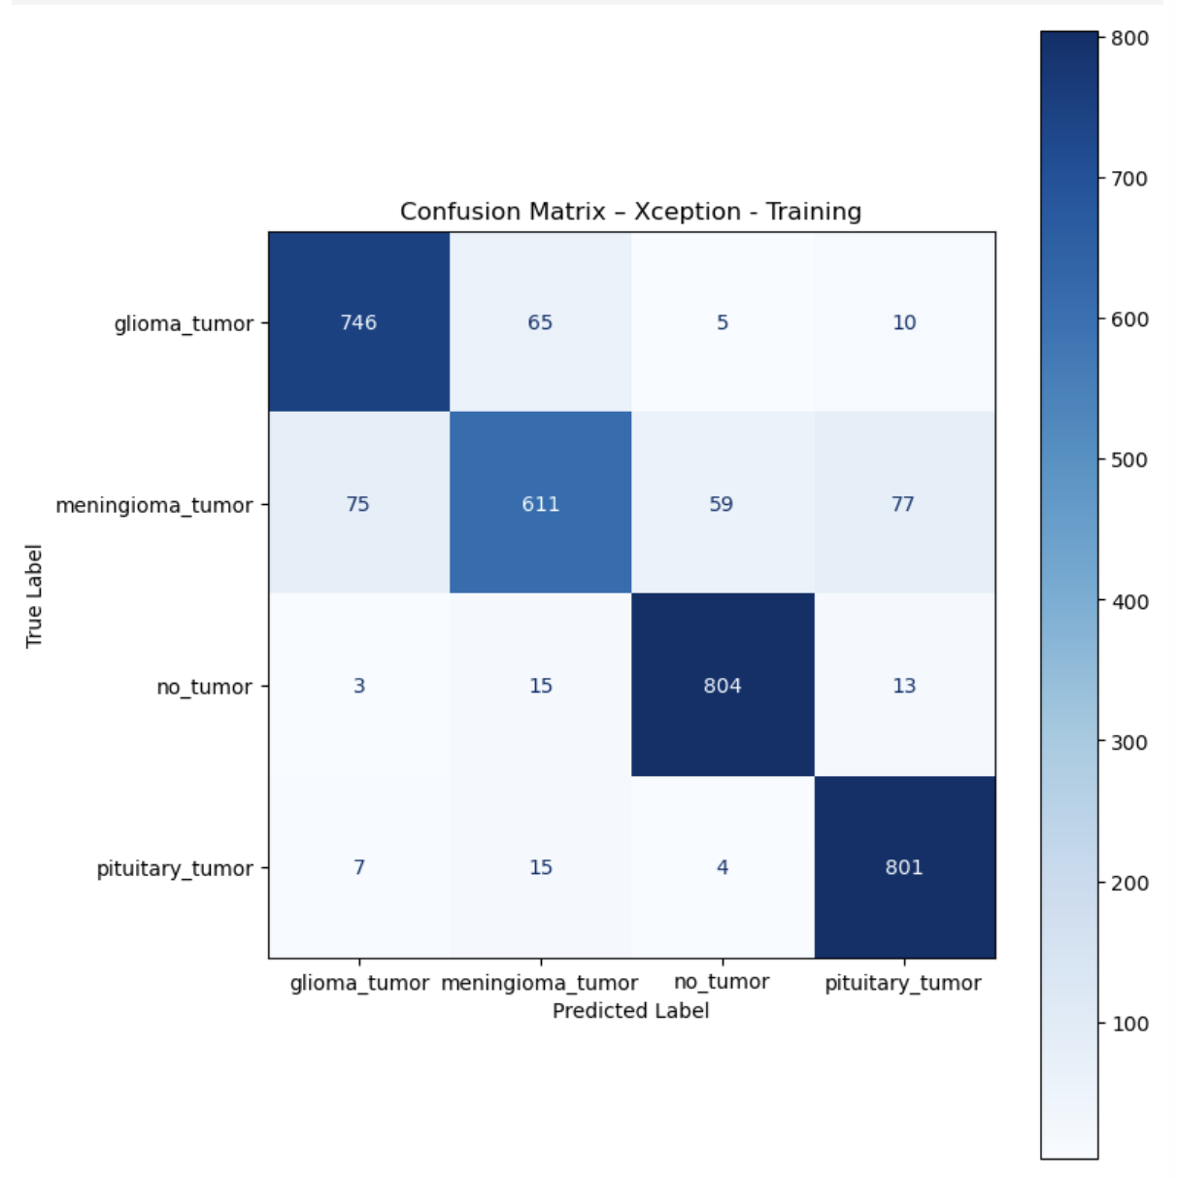
Confusion Matrix
DenseNet121 slightly outperformed Xception on meningioma and pituitary tumor detection
Correctly classified 9–10 more images in those categories
Sparked interest in fine-tuning Xception to match or exceed that performance

Slide 10
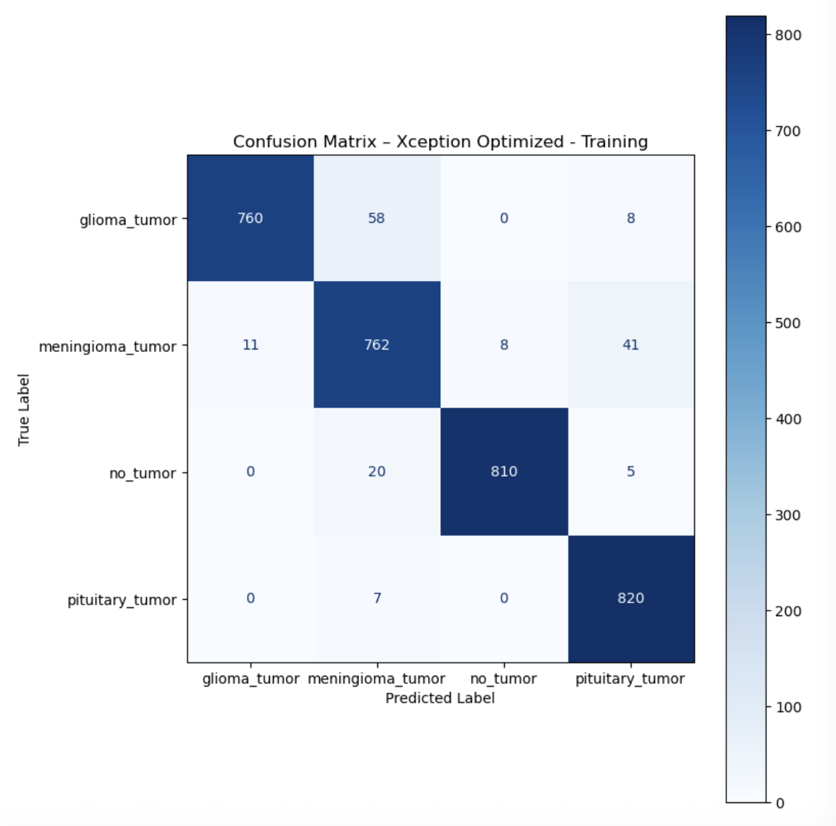
Model Optimization
Manual Optimization: Xception Model
Increased Dense layer size from 64 → 256 neurons
Reduced dropout rate from 30% → 10%
Model architecture unchanged beyond hyperparameters
Achieved significant performance boost:
Precision: 95.23%
Recall: 95.22%
F1-Score: 95.23%
Accuracy: 95.23%
Confusion matrix shows improved predictions across all 4 tumor classes

Slide 11
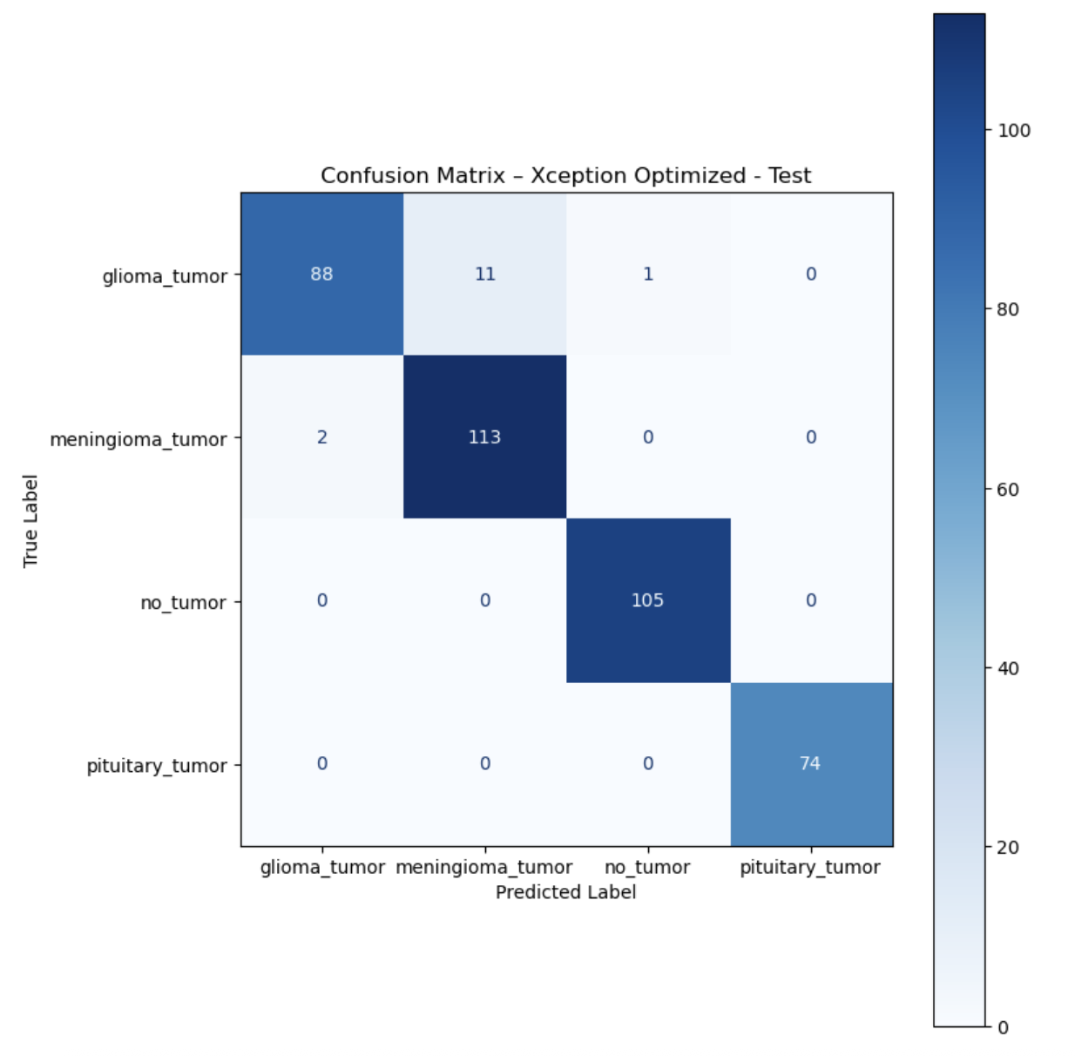
Testing the Final Model
Evaluated on 394 test images, preprocessed identically to training data
Achieved strong generalization on unseen data:
Precision: 97%
Recall: 96.5%
F1-Score: 96.7%
Accuracy: 96%
Confusion matrix shows consistent diagonal predictions across all four classes
Minimal misclassifications suggest no overfitting or underfitting
Confirms the model’s reliability for real-world application

Slide 12
Recommendations
Streamline Workflow: Automate MRI scan classification to free up clinicians for personalized treatment planning.
Support Research: Analyze tumor patterns and demographics to uncover trends in patient susceptibility.
Enable Early Detection: Integrate as a screening tool for identifying tumors in high-risk individuals.
Suggestions For Improvement
Class-Specific Fine-Tuning
Retrain only on glioma and meningioma samples using a smaller model or the last few layers of Xception
Helps the model learn subtle differences it may be glossing over in full multiclass training
Hybrid Models or Ensemble Support
Add a small SVM or decision tree classifier trained specifically on glioma vs. meningioma embeddings
Acts as a second opinion for the neural network’s toughest calls
Can be integrated post-prediction for refined decision logic

